Slide 1
Practice Lab:
This Practice Lab is dependent on Discussion Unit 7544, where most of the objects we create in this lab were introduced.
This Practice Lab requires a working DSE system, with DSE Analytics enabled.
Because of the dependency on the "dse spark" utility, this Practice Lab requires a ssh(C) prompt on at least one node operating DSE Analytics.
Artifacts created in this Practice Lab are used by other Practice Labs that follow. So, it is important you complete the minimal challenges as outlined.
DSE Analytics, Word Count (first example), RDDs, Transforms, Actions, read and write from DSE
Notes:
The goal of this Practice Lab is to read and write from DSE using RDDs.
Runtime requirements are detailed in the slide above.

Slide 2


Challenge 1: Locate the Spark Master, state
# from any DSE node (both commands)
dse client-tool spark master-address
dse://127.0.0.1:9042?connection.local_dc=DC1;connection.host=;
dsetool ring
Address DC Rack Workload Graph Status State Load Owns Token Health [0,1]
127.0.0.1 DC1 RAC1 Analytics(SM) no Up Normal 116.01 KiB ? -5915474479483571799 0.40
Note: you must specify a keyspace to get ownership information.
9042 ??
SM == Spark Master
Notes:
Complete the following:
Unless otherwise stated, every step in this Practice Lab is run from a command line prompt on a DSE node configured for DSE Analytics.
Run the dse and dsetool commands as shown.
From the output above, we were running on a single node DSE cluster configured to run DSE Analytics.
The Spark Master is on 127.0.0.1.
What is port 9042 used for ?
Reference Urls,
https://docs.datastax.com/en/dse/6.0/dse-admin/datastax_enterprise/security/secFirewallPorts.html

Slide 3
Challenge 2: Spark UIs
All of the REPLs are idiomatic, which you see from the exit commands
Spark/SQL, generally ANSI SQL/99+, Hive/QL(Hive/SQL) 1.2.2; OLAP, not OLTP
pyspark is a Python command interpreter
sparkR will fail without given R language dependencies being met
dse spark-sql
exit;
dse pyspark
quit()
dse sparkR # Will fail
Notes:
Complete the following:
Largely we detail these commands so that you know they exist. We don't really use these REPLs in this Practice Lab.
Start and exit all of the REPLs detailed above.
Reference Urls,
Hive command reference, https://cwiki.apache.org/confluence/display/Hive/LanguageManual+DML

Slide 4

Challenge 2: Spark UIs
Stay in "dse spark", and start a second subsequent session in another terminal window minutes later
These are actually Scala interpreters; you don't need to run Spark
An 'action' submits a Spark jop
dse spark
CONTROL-L // to clear screen
:quit
Creating a new Spark Session
Spark context Web UI available at http://172.16.119.194:4040
Spark Context available as 'sc' (master = dse://?, app id = app-20180619165450-0001).
Spark Session available as 'spark'.
Spark SqlContext (Deprecated use Spark Session instead) available as 'sqlContext'
Notes:
Complete the following:
At one Linux terminal window, enter the DSE Spark REPL via a, "dse spark".
Wait until this first window is clearly initialized.
Then use a second terminal window and again enter, "dse spark".
Both of the above are Scala REPLs, and can run general/whatever Scala commands; variable assignments, other.
You will soon realize that the second window will hang when/if you try to execute Spark commands. Why ?
The Spark Master offers a Web UI at, http:// (Spark master IP) : 7080
Each Spark client offers a WEB UI of it's own at, http:// (Spark client IP) : 4040
This number 4040 is incremented for each Spark client. So, 4040, is followed by 4041, 4042, etcetera.
There are also links to the Spark clients, from the Spark master page.
On second and subsequent clients you will see a message similar to,
WARN 2018-07-11 09:05:51,097 org.apache.spark.util.Utils: Service 'SparkUI' could not bind on port 4040. Attempting port 4041.

Slide 5
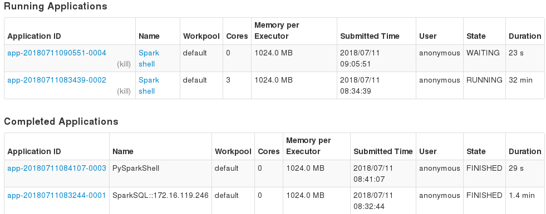
Challenge 2: http::// (Spark master IP) :7080
Notes:
Complete the following:
View the Spark master Web UI at, http:// (Spark master ip) :7080 (localhost:7080)
Notice that the second "dse spark" command is currently blocked.
You can get to the Spark client Web UI via a trail of links, starting near the Red arrow. This UI will be largely empty for now, since our Spark client hasn't done anything yet.

Slide 6

Challenge 2: dse spark, options
dse spark
--master spark://127.0.0.1:7080
--name NNN
--driver-memory 512M
--executor-memory 1G
--total-executor-cores N
Exit all but one Spark REPL
Notes:
Complete the following:
The "dse spark" command offers command line options to specify resource consumption.
The --name argument allows you to specify a specific/variable name for your application; perhaps make it easier to find this application from the Spark master Web UI.
The default number of cores is, ALL. In place of N, specify a whole integer number.
Other values display the default values; 512M, and 1G.
We wont experiment with these settings now, as you may be on a laptop, short of resource as it is.

Slide 7
About the REPLs:
Connects to Spark master, [ Spark commands ] run as jobs from a DAG, ..
All rules apply; lazy evaluation, other
SparkContext predefined as, sc
SparkSession as, spark (SQL, Hive, other resources)
Some cheats available; syntax not entirely same/rigid as a true program. (Similar to Gremlin development versus production.)
Notes:
Comments about the REPLs:
About the Scala REPL, an action submits a DAG, a Spark job. All other commands are interpreted by the Scala run time; that, and lazy evaluation.
The Scala REPL syntax is more forgiving than a Scala compiled program. I.e., you can reassign a val, (a static variable).

Slide 8
Challenge 3 (Optional):
Implement Word Count from Discussion Unit 7544
As a simple 2-4 line task, we'll use the spark REPL as our IDE
Easier to check classes, other.
Read/write to/from DSE using RDDs.
Word Count (Hello World)
Notes:
Complete the following:
Implement Word Count, as detailed on the pages that follow.

Slide 9

Challenge 3 (Optional): Simple ASCII text file
Create a simple ASCII text file with data similar to,
111, Bob, Mary
222, Ted
333, Alice, Bob, Harold
444, Dave, Bob
Short/simple absolute pathname
Notes:
Complete the following:
Create a multi-line, simple ASCII text field with data similar to that as shown.
You will need an absolute pathname to this file; keep it short and simple.

Slide 10
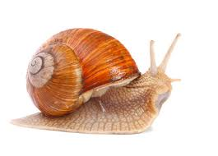
Challenge 3: The Scala, Spark code
val records = sc.textFile("file:///opt/stores_db/7545_HelloWorld.csv")
val words = records.flatMap( record => record.split(",").drop(1) )
val counts1 = words.map( word => (word, 1) )
val counts2 = counts1.reduceByKey{ case(x, y) => x + y }
counts2.collect().foreach(println)
( Dave,1)
( Harold,1)
( Alice,1)
( Bob,3)
( Mary,1)
( Ted,1)
Notes:
Complete the following:
Using the Spark REPL, implement Word Count as shown.
Use, id.getClass() often, where id is the name of your (RDD) or other Scala object.
Keep a history of the commands that work in a separate text file.
Be prepared to defend/discuss (comprehend) your work.

Slide 11

Challenge 3: Two Transforms (Derivations)
val recs_withDerived = counts2.map
{ case(name, cnt) =>
(name, cnt, name.toUpperCase ) }
Notes:
Complete the following:
Implement the two data derivations outlined in Discussion Unit 7544; upshift (toUpperCase), and (generate a flag based on a value).
Sample code provided above; the identifiers/other will not match.

Slide 12

Challenge 3: Two Transforms (Derivations)
object MyFunctions {
def generateFlag(arg: String) : String = {
if (arg > "M")
"E-USA"
else
"W-USA"
}
}
val recs_withDerived = counts2.map { case(name, cnt) =>
(name, cnt, name.toUpperCase,
MyFunctions.generateFlag(name) ) }
recs_withDerived.collect().foreach(println)
Notes:
Complete the following:
Implement the two data derivations outlined in Discussion Unit 7544; upshift (toUpperCase), and (generate a flag based on a value).
Sample code provided above; the identifiers/other will not match.

Slide 13



Challenge 3: Read/Write to/from DSE
Use getClass() to prove this.
At this point, you've likely created a 4 column RDD. Sample code is for 2 columns.
Using CQLSH, create a similarly structured DSE/CQL table to read and write from.
Notes:
Complete the following:
Create an (n) column DSE table with appropriate columns and keys.

Slide 14
Challenge 3: Write to DSE using RDDs
case class My_Record (pk: Int, value: String)
val my_records = sc.parallelize(Seq(
new My_Record(555, "Luis, Earl"),
new My_Record(666, "Ann, Sally, Bob"),
new My_Record(111, "Bob, Tony")
))
my_records.saveToCassandra("ks_7545", "hello_world",
SomeColumns("pk", "value"))
// From CQLSH
SELECT * FROM ks_7545.hello_world ;
Notes:
Complete the following:
Create a class record similar to the DSE table you wish to write to.
Create an RDD from a List of class records similar to that as shown.
And insert into DSE.
Use CQLSH to verify results.

Slide 15
Challenge 3: Read from DSE using RDDs
val rows = sc.cassandraTable[My_Record]("ks_7545", "hello_world").
select("pk", "value").
as( (i:Int, s:String ) => new My_Record(i, s) )
rows.collect().foreach(println)
Notes:
Complete the following:
Read from the DSE table you just populated; execute a fetch loop similar to that as shown.

Slide 16
Challenge 4:
We need to load the customer, orders, and items tables from CSV; we use these tables in later Practice Labs, and need these tables to exist and have data.
Some degree of busy work; load at least customer using Spark. You can cheat and use CQL/other for orders and items.
Derive the DSE models from the SQL DDL. Do all DDL using CQLSH.
Add two columns to customer to support the new, derived data.
Load customer, orders, items DSE tables from CSV
Notes:
Complete the following:
Some of the steps that follow are CQL, and can be run from CQLSH, DSE Studio, other.
Some of the steps should be written in Spark/Scala, other.
Sample CQLSH to load/unload-
COPY ks_7545.customer
(
customer_num,
fname ,
lname ,
company ,
address1 ,
address2 ,
city ,
state ,
zipcode ,
phone
)
TO 'ks_7545.customer.csv'
WITH HEADER = TRUE ;
TRUNCATE ks_7545.customer;
COPY ks_7545.customer
(
customer_num,
fname ,
lname ,
company ,
address1 ,
address2 ,
city ,
state ,
zipcode ,
phone
)
FROM 'ks_7545.customer.csv'
WITH HEADER = TRUE ;

Slide 17

Working Goal:
From: Maury_Atwater
To: DSE_HOTSHOT
Subject: Need this now !!!
Attached are 3 (count) SQL DDL files, customer, orders, and items, and 3 (count) ASCII Text CSV files.
I need these loaded into DSE now !!!
On customer.zipcode, derive an east coast, west coast flag ("E-USA", "W-USA").
Also derive customer.company (company name) to uppercase.
-MA
Maury Atwater, President of Atwater's
Notes:
The email above, lists our working goal.

Slide 18
Challenge 4: Load customer, order, items
The instructor will specify the location of (n) ASCII text files-
SQL DDL for customer, order, items. Convert to CQL DDL; create whatever keyspace and tables.
Load all 3 tables from CSV; use Spark/Scala for at least customer.
Derive the 2 new columns for customer as specified on previous page.
Don't worry about optimizing the data model. that work will come. Just do a 1:1 SQL -> CQL mapping.
Notes:
Complete the following:
Overall, the goal is to load; customer, order, items. We need these tables to exist and contain data for further Practice Labs that follow.
You will be pointed to SQL DDL, and ASCII text CSV files.
Baby steps ? Load order as is first. Then create a second copy of the table with the two new, derived columns.
Don't worry about optimizing the data model; that work is coming.
Every step in this lab against customer, order, items, has been done against an earlier table/dataset.
Keep a clear record of each (Scala statement, step) you complete; you need these instructions later.

Slide 19

Challenge 4: You are done when ..
All three tables exist in DSE and have data; customer, orders, items
You have at least the steps to complete customer in a nice (list)
Notes:
Complete the following:
You are done when all three tables exist and have data.
You have at least the steps to complete customer in a nice (list).

Slide 20

Practice Lab:
Lessons learned
Notes:
Discuss what worked well, poorly, from the Practice Lab.

Slide 21
End of Unit:
Notes:
End of Practice Lab-

